Slide 1
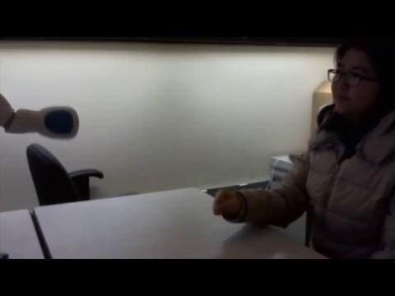
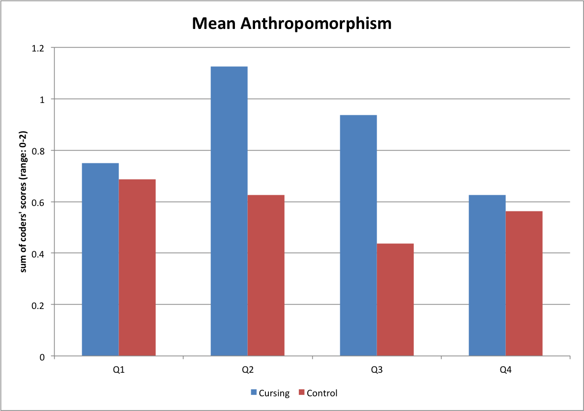
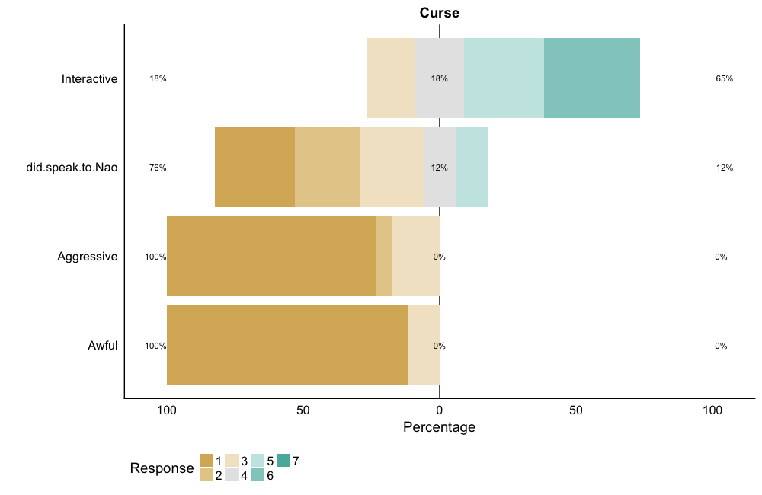
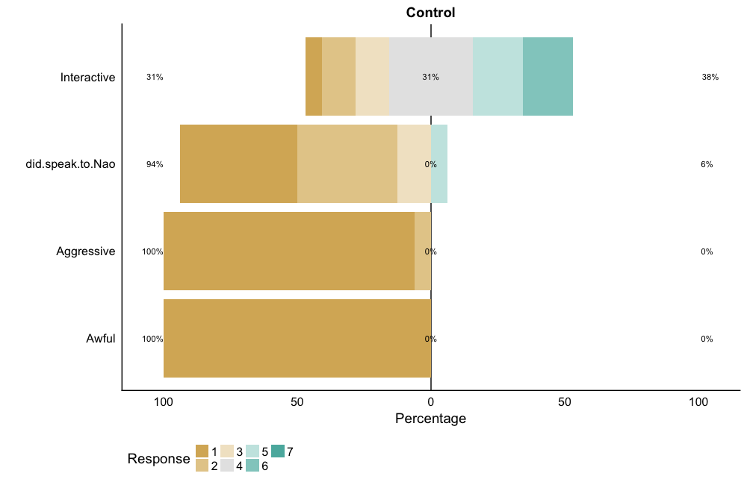
Oh #$&! Perceptions of a Cursing Robot
Cursing causes humans to consider a robot more anthropomorphic, and elicits laughter, but it does not elicit more social behavior as cheating does

